Slide 1
Tutorial 1 Learning Topology Optimization Through Examples and Case Studies
August 18, 2019

Slide 2
Multi-load Design Optimization

Slide 3
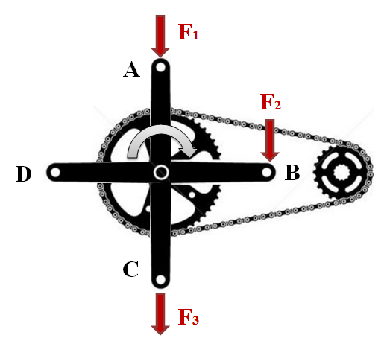
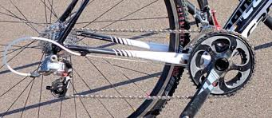
Motivation
The crank arm subject to multi-load during a pedaling cycle.
How to optimize design w.r.t all loading scenarios?

Slide 4
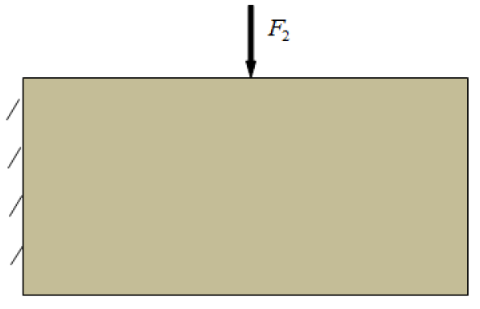
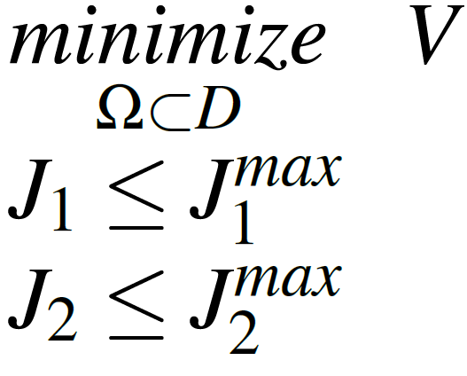
Multi-Load Example
Load 1
Load 2
Topological sensitivity for compliance J

Slide 5
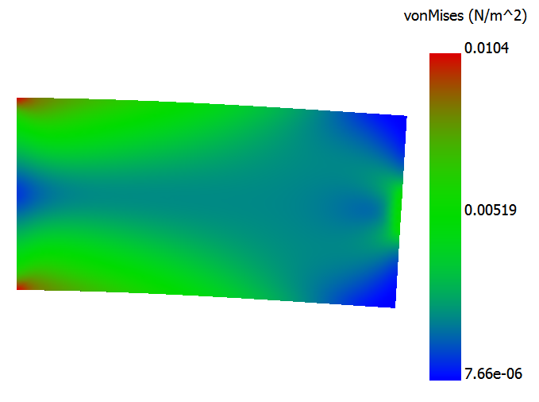
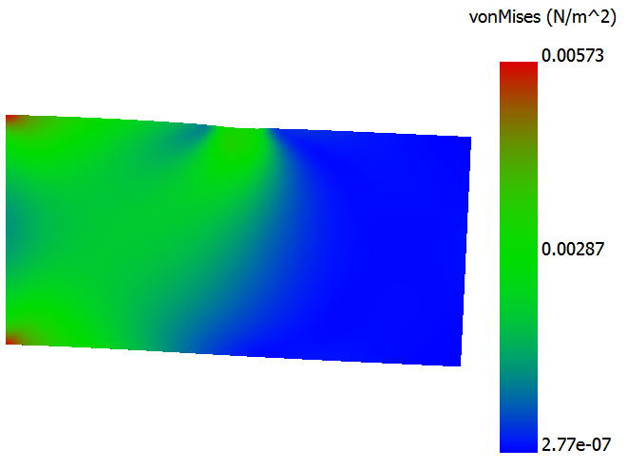
Worst -Case
Load 1
Load 2
Worst Case!

Slide 6
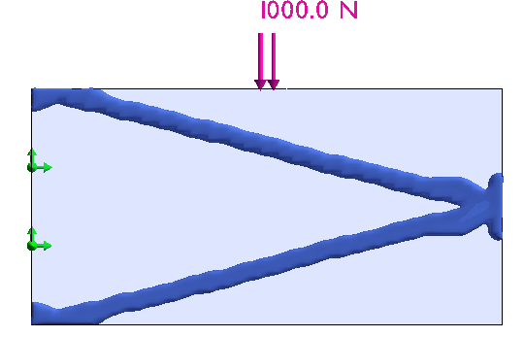
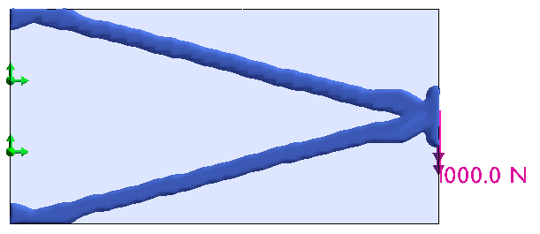
Worst –Case: Load 1
Load 1
V = 0.17 V₀
J₂=∞

Slide 7
Multi-Load Example
Load 1
Load 2
Topological sensitivity for compliance J

Slide 8
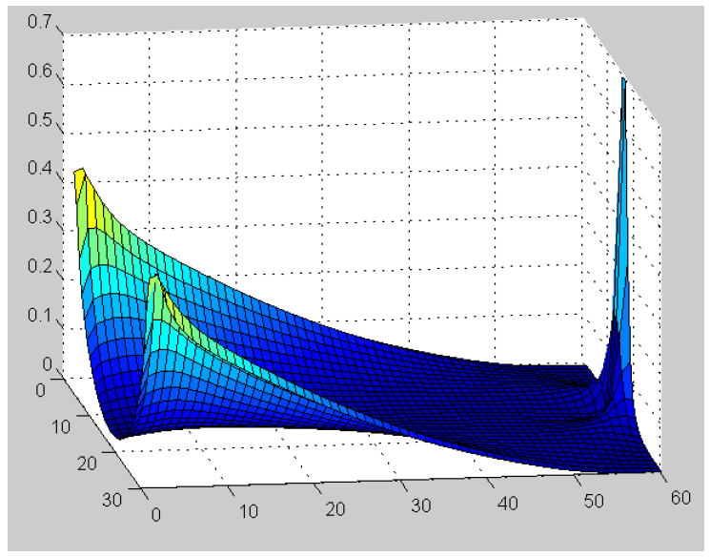
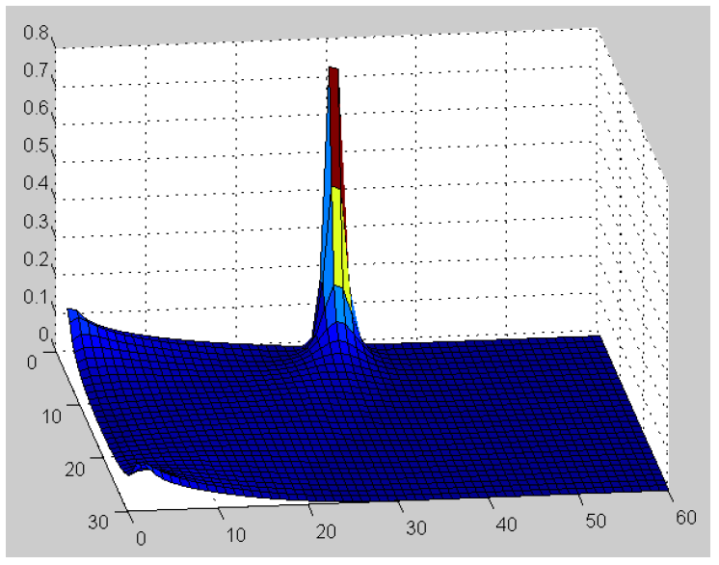
Topological sensitivity
Load 1
Load 2

Slide 9
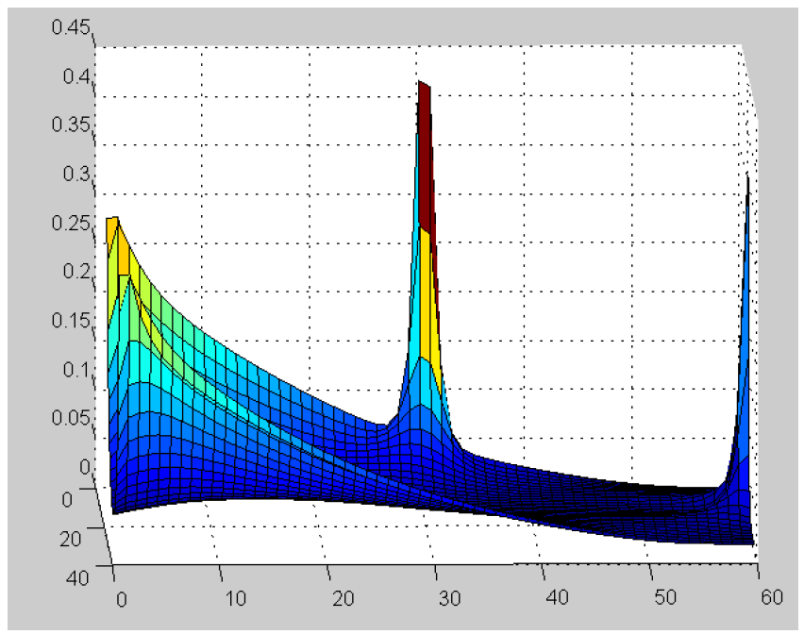
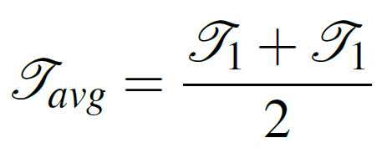
Averaging Sensitivity Fields
Load 1
Load 2

Slide 10
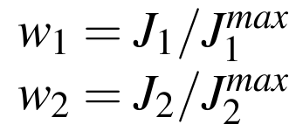
Adaptive Weighting
Load 1
Load 2
Weighting
More restrictive!

Slide 11
Linear Adaptive Weighting
Load 1
Load 2
Weighting
More restrictive!

Slide 12
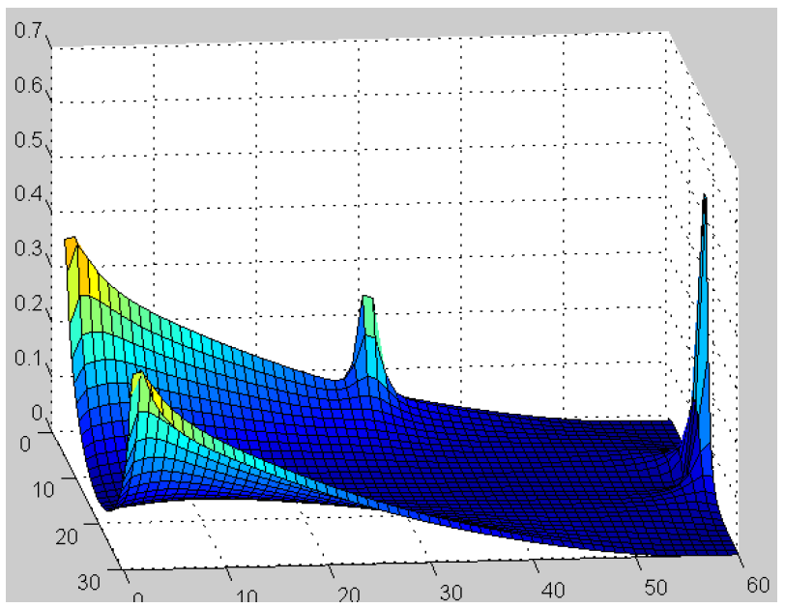
Linearly Weighting TS
Load 1
Load 2

Slide 13
Crank Arm Case Study
FEA

Slide 14
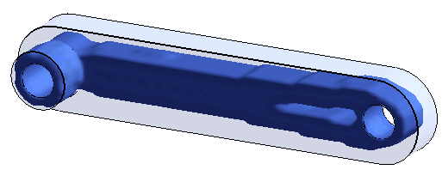
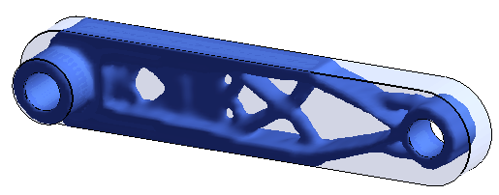
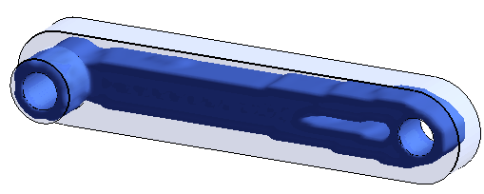
Crank Arm Case Study
Optimized (each load)

Slide 15
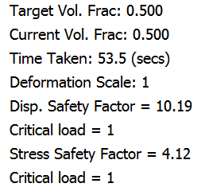
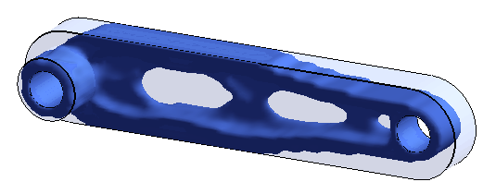
Crank Arm Case Study
Optimized (all loads)

Slide 16
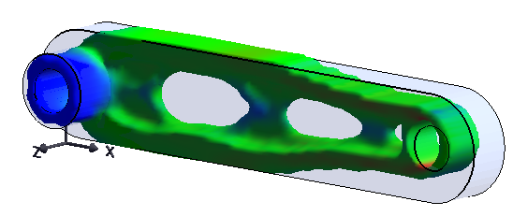
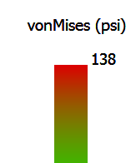
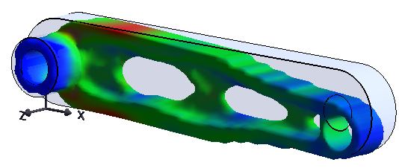
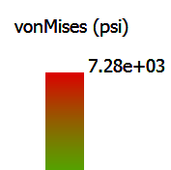
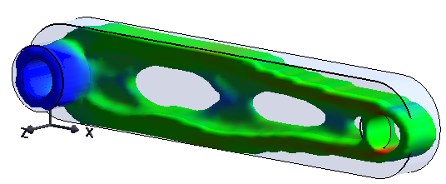
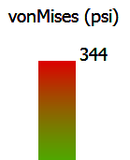
Crank Arm Case Study
Post-optimization

